Slide 1
Advanced Database Functions
Jeremy Bergmann - Omaha Data Science Academy

Slide 2
Appendix A – Stored Procedures
Definition: routines that do not return values and can take input or output parameters; called explicitly
CREATE PROCEDURE procedure_name(IN|OUT|INOUT variable_name data_type, ...)
BEGIN
DECLARE variables|cursors|constants;
... Add SQL code here
END$$
DELIMITER ;
Call the procedure:
CALL procedure_name(variable1, variable2, ...);

Slide 3
Appendix B – Functions
Definition: routines that return values (usually in select statement) and may take input parameters, called explicitly.
CREATE FUNCTION function_name(variable_name data_type, ...) RETURNS data_type
BEGIN
DECLARE variables|cursors|constants;
... Insert your code here
RETURN (variable);
END$$
DELIMITER ;
Call the function:
SELECT function_name(variable) FROM DUAL;

Slide 4
Routines
Definition: program modules that execute on demand
Procedures: routines that do not return values and can take input or output parameters; called explicitly
Functions: routines that return values and take input parameters
Triggers: routines that execute in response to a database event; event-driven
Triggers
Returns Value or Performs Routine
Procedures & Functions
Performs Trigger Action
INSERT
UPDATE
DELETE
Trigger
DB
Stored Routine
Call routine_name
(input_value)
Code
Code
Notes:
Benefits
Performance improves for compiled SQL statements
Reduced network traffic
Improved security
Improved data integrity
Thinner clients
Transaction: one or more updates that must be completely processed or not processed at all
ROLLBACK if any update fails
COMMIT at end if there are no issues
Testing SAVEPOINT:
CREATE TABLE test (test_column integer);
DELIMITER $$
DECLARE i integer DEFAULT 0;
SET i = 1;
BEGIN
INSERT INTO test (test_column) VALUES (10/i);
SET i = i - 1;
SAVEPOINT A;
INSERT INTO test (test_column) VALUES (10/i);
COMMIT;
EXCEPTION
WHEN ZERO_DIVIDE THEN ROLLBACK TO SAVEPOINT A;
END;

Slide 5
SQL/Persistent Stored Modules (SQL/PSM)
Definition: procedural language is used to create routines to:
Declare constants, variables, and cursors
Execute program logic (i.e. conditions and loops)
Handle exceptions (i.e. errors) that occur during runtime
DELIMITER $$ #mandatory
CREATE routine_name #mandatory
BEGIN #mandatory
DECLARE #optional
...
END$$ #mandatory
DELIMITER ; #mandatory
Notes:
DELIMITER changes the delimiter to what is specified (e.g. $$). Delimiters are used to distinguish one line of code from another
CREATE routine_name will create the procedure, function, or trigger
DECLARE provides the ability to specify variables, constants, and cursors
BEGIN executes program logic (mandatory) such as IF and LOOP
END finishes the routine
DELIMITER again resets the delimiter back to normal (e.g ;)

Slide 6
Declaring Variables
Definition: specifies the value of certain variables that can be used by code later on in the processing logic.
x = 5
y = x + 5
DECLARE x data_type;
SELECT `column` INTO x
FROM `table`...;

Slide 7
If/Then Logic
Definition: The IF/THEN/ELSE logic evaluates certain criteria and returns certain results when the criteria is met.
IF (condition) THEN
#logic if condition is true;
ELSEIF (condition) THEN
#logic if condition is true;
ELSE
#logic if all conditions are false;
END IF;

Slide 8
Procedures
Definition: routines that do not return values and can take input or output parameters; called explicitly
DELIMITER $$
CREATE PROCEDURE procedure_name(IN|OUT|INOUT variable_name data_type, ...)
BEGIN
DECLARE variables|cursors|constants;
...
END$$
DELIMITER ;
Call the procedure:
CALL procedure_name(variable1, variable2, ...);
Notes:
IN passes an argument to the stored procedure which will not change even if it is changed in the procedure
OUT the variable can change and be used outside the procedure but the initial value cannot be used
INOUT passes an argument to the stored procedure which can change and be used outside the procedure

Slide 9
Procedure Example
Procedure: Create a procedure that updates the price of all products by a specified percentage chosen by the user. Call this procedure to increase all product prices by 10 percent and display the new prices.
DELIMITER $$
CREATE PROCEDURE price_update(IN vPercentage double(10,2))
BEGIN
UPDATE `product`
SET `price` = `price` * (1 + vPercentage);
SELECT `description`, `price` FROM `product`;
END$$
DELIMITER ;
Call the procedure:
CALL price_update(.1);

Slide 10
Functions
Definition: routines that return values and may take input parameters, called explicitly
DELIMITER $$
CREATE FUNCTION function_name(variable_name data_type, ...) RETURNS data_type
BEGIN
DECLARE variables|cursors|constants;
...
RETURN (variable);
END$$
DELIMITER ;
Call the function:
SELECT function_name(variable) FROM DUAL;

Slide 11
Function Example
Function: Create a function named get_payment_type that returns the payment type for a particular order.
DELIMITER $$
CREATE FUNCTION get_payment_type(vOrderID integer) RETURNS varchar(50)
BEGIN
DECLARE vPmtType varchar(50);
SELECT DISTINCT `description` INTO vPmtType
FROM `payment` p
JOIN `payment_type` pt ON p.payment_type_id = pt.payment_type_id
WHERE p.order_id = vOrderID;
RETURN (vPmtType);
END$$
DELIMITER ;
Call the function:
SELECT `order_id`, get_payment_type(`order_id`) AS `pmt_type`
FROM `order`
ORDER BY `order_id`;

Slide 12
Triggers
Definition: routines that are invoked automatically when a change is made to the data on the associated table; event-driven
DELIMITER $$
CREATE TRIGGER trigger_name
[BEFORE|AFTER] [INSERT|UPDATE|DELETE] ON `table_name`
FOR EACH ROW
[FOLLOWS|PRECEDES] existing_trigger_name
BEGIN
...
END$$
DELIMITER ;
Notes:
BEFORE|AFTER INSERT|UPDATE|DELETE will determine when this trigger will execute (see next slide)
BEFORE INSERT activated before data is inserted into the table
AFTER INSERT activated after data is inserted into the table
BEFORE UPDATE activated before data in the table is updated
AFTER UPDATE activated after data in the table is updated
BEFORE DELETE activated before data is removed from the table
AFTER DELETE activated after data is removed from the table
FOR EACH ROW will execute this trigger for each row
FOLLOWS means that the trigger will execute after other existing triggers; PRECEDES means that the trigger will execute before other existing triggers;

Slide 13
Trigger Example
Trigger: Create a trigger that checks whether the order date entered is not today.
DELIMITER $$
CREATE TRIGGER check_date
BEFORE INSERT ON `order`
FOR EACH ROW
BEGIN
IF new.order_date <> Curdate() THEN
SIGNAL SQLSTATE '45000' SET message_text =
'TriggerError: The order date has to be today.';
END IF;
END$$
DELIMITER ;
Call the trigger:
INSERT INTO `order` (`customer_id`, `order_date`, `fulfillment_date`, `salesperson_id`, `ship_address_id`)
VALUES (1, '2019-11-13', NULL, 3, NULL);
Notes:
To test the trigger, insert a record:
INSERT INTO orders (customer_id, order_date, fulfillment_date, salesperson_id, ship_address_id)
VALUES (1,'2019-11-13','',3,NULL);

Slide 14
Remove Procedures, Functions, or Triggers
To remove procedures, functions, or triggers, use the DROP command:
DROP PROCEDURE [IF EXISTS] procedure_name;
DROP FUNCTION [IF EXISTS] function_name;
DROP TRIGGER [IF EXISTS] trigger_name;

Slide 15
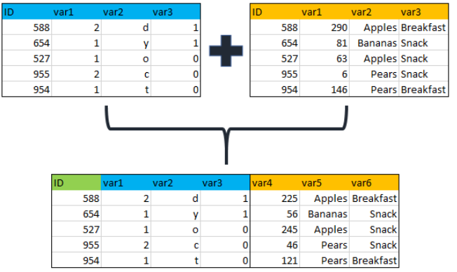
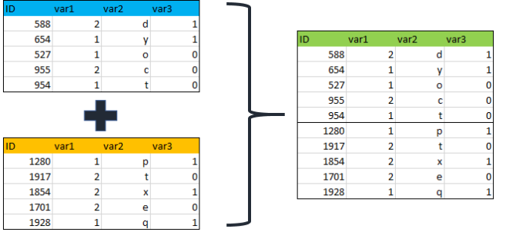
Review: Class 5 – Cleaning Data Using SQL
Joining & Merging Data
Joining Data - inner, outer and left Merging/Appending Data – Union/Union All
Notes:
Feynman technique: Learn -> Explain -> Reflect -> Repeat
What are the most important ideas from last class? Write a summary of the information as if explaining to a 14 year old. Avoid jargon Keep the words and sentences simple Rely on memory Make the explanation visual, if possible Note where you had difficulty or have knowledge gaps. These indicate things you should review, research, or ask questions about

Slide 16

Class 6 Objectives
Advanced SQL Functions
SQL Operators, Wildcards, Like, etc.
Case Statements & Logical Functions
Clean string, numeric, and date data
Perform joins - inner, outer and left
Notes:
Feynman technique: Learn -> Explain -> Reflect -> Repeat
What are the most important ideas from last class? Write a summary of the information as if explaining to a 14 year old. Avoid jargon Keep the words and sentences simple Rely on memory Make the explanation visual, if possible Note where you had difficulty or have knowledge gaps. These indicate things you should review, research, or ask questions about

Slide 17
What is the need for data manipulation?
Creating new datasets & Combine disparate data sets
Perform common queries, aggregations, and joins
Adding, removing, or modifying data
Extracting and Storing Data
Creation/Extraction
Transforming data
Cleaning data
Storage & Retrieval
Notes:
Creation: creating tables and databases, the things
Storage: where data are stored
Cleaning: adding, removing, or modifying data
Retrieval: selecting only the data you want

Slide 18
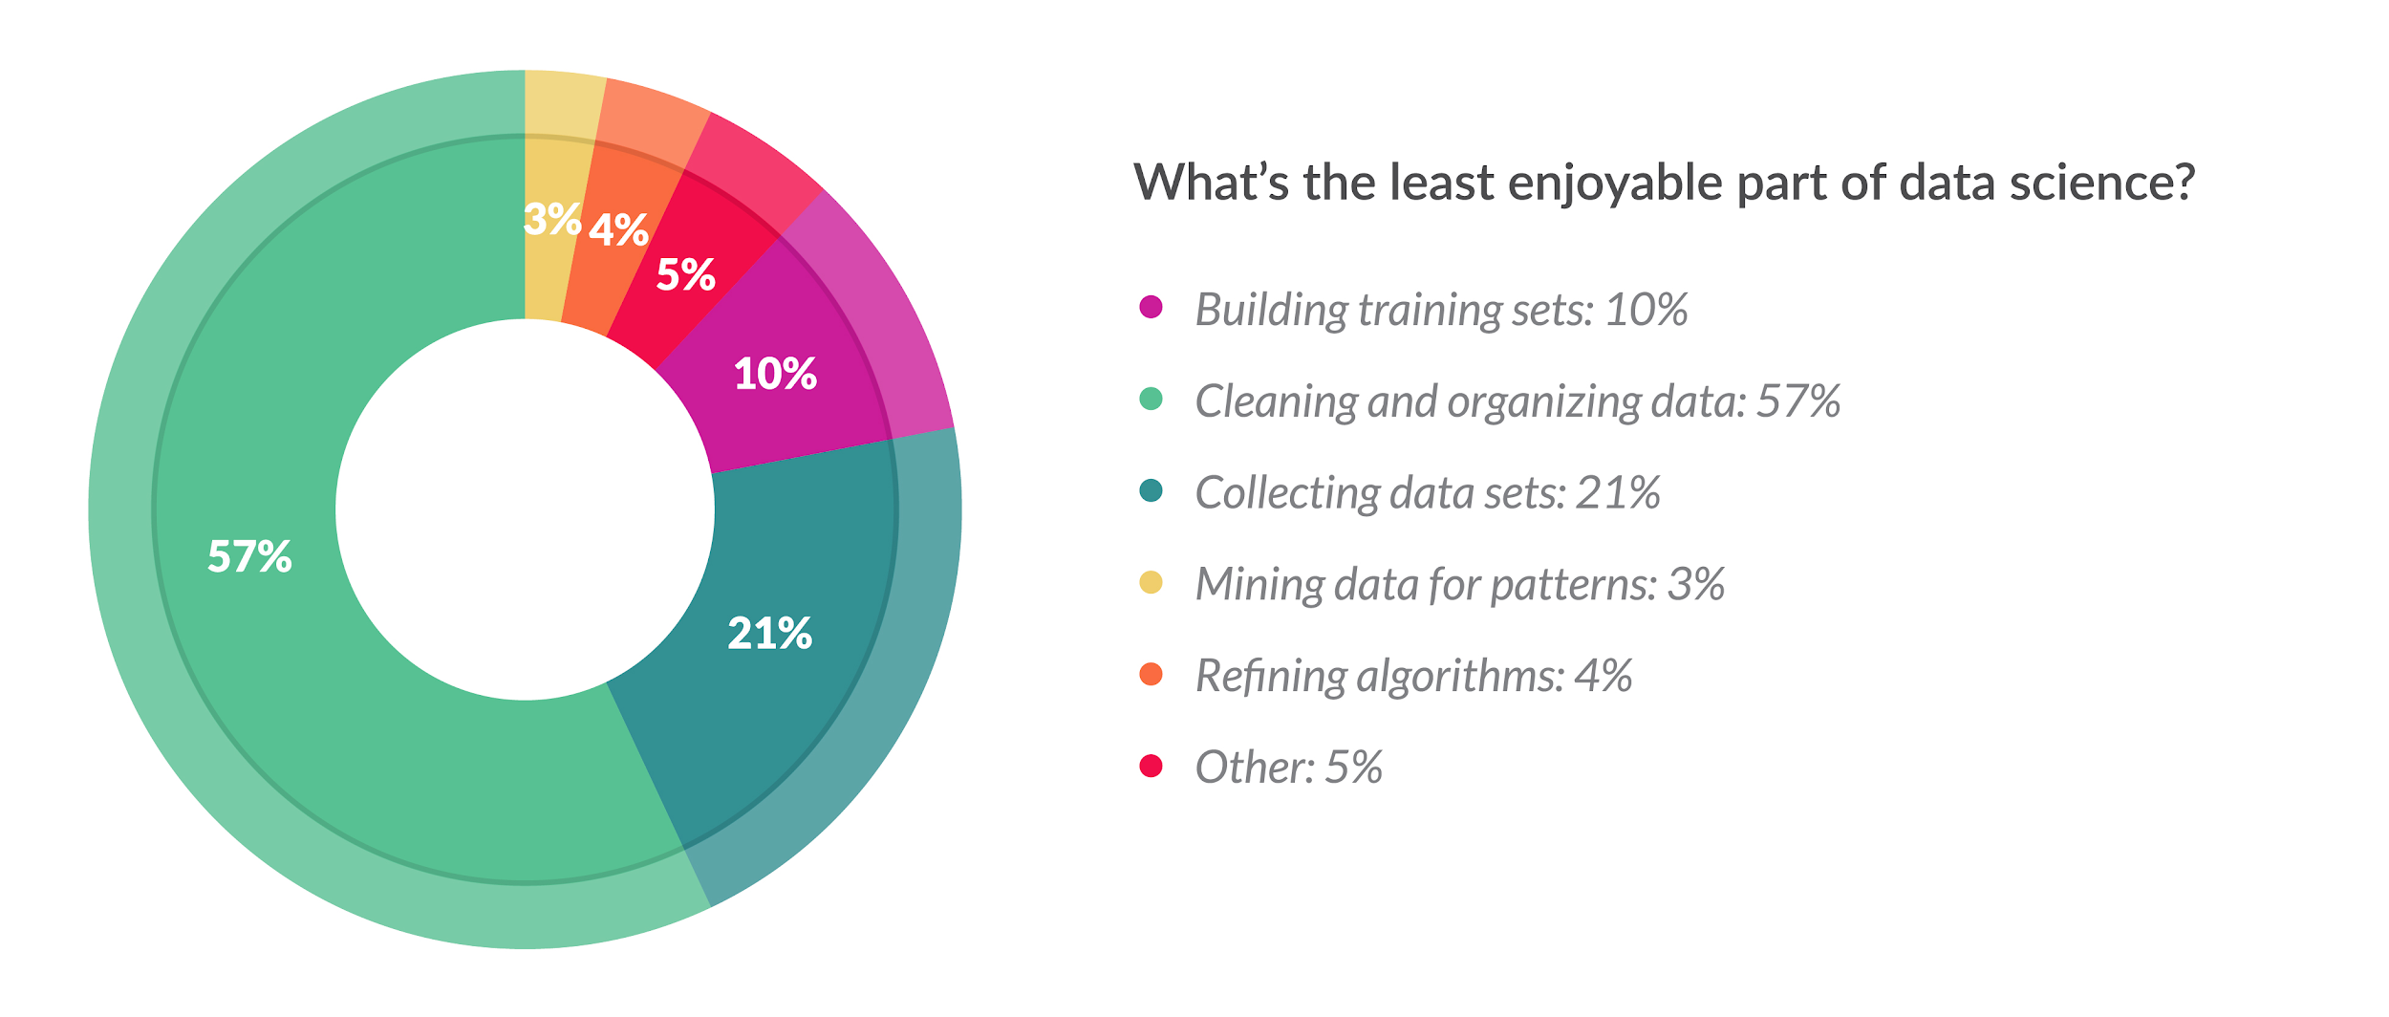
Cleaning Data
What Does Cleaning Data Mean?
Data cleaning is the process of confirming the Validity, Accuracy, Completeness, Consistency, and Uniformity data
How Can You Clean Data?
Using business knowledge, along with software tools or a coding language to clean data.
What About Programming Languages?
Cleaning data in a language like SQL or Python gives you flexibility to run routines for specific projects, while keeping costs low
Python: Pandas, Dora, data cleaner, tabulate, scrubadub, and many other Python libraries.
SQL: T-SQL, Text & Date Functions, Case Statements, “Where” clause, Select Distinct
Notes:
Validity - absence of differences between the data items representing the same objects based on specific information requirements
Accuracy - degree to which the data item correctly describes the object in context of appropriate real-world context and attributes
Completeness - An indication of the comprehensiveness of available data,
Consistency - absence of differences between the data items representing the same objects based on specific information requirements (across data sources/Tables)
Uniformity - Absolute, or very high degree of, comparability between two or more alternatives, processes, products, qualifications, sets of data

Slide 19
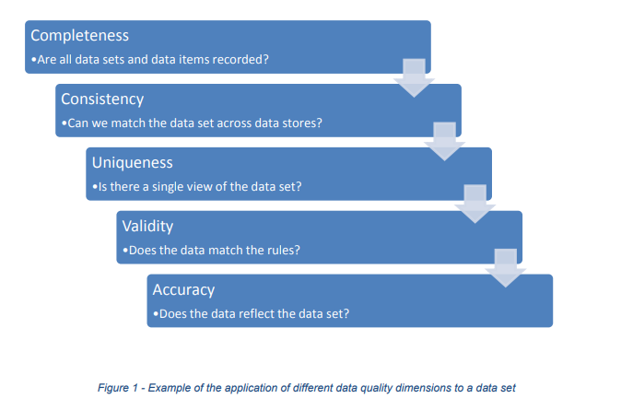
Goals of Cleaning Data
Remove Unwanted Observations
Duplicate Observations arise when you combine datasets from multiple places, scrape data, and receive data from clients/other departments.
Irrelevant Observations & Outliers are those that don’t fit the specific problem you’re trying to solve.
Fix Structural Errors that occur during measurement or data transfer.
Ex. Multiple ways to spell a word or mislabeled classes.
Handle Missing
Dropping observations that have missing values
Imputing the missing values based on other observations.
There are other possible ways to clean data, such as: (transforming files, statistical methods) but these steps will always be performed on any dataset you analyze.
Notes:
The goal of cleaning is ultimately to confirm the Validity, Accuracy, Completeness, Consistency, and Uniformity of the dataset

Slide 20
Case Statements
Purpose - The CASE statement goes through conditions and return a value when the first condition is met (like an IF-THEN-ELSE statement). If no conditions are true, it returns the value in the “ELSE” clause.
Syntax
CASE WHEN condition1 THEN result1 WHEN condition2 THEN result2 WHEN conditionN THEN resultN ELSE result END;
Example
SELECT vw.country,
CASE WHEN country = 'India' THEN 'Gandhi’ WHEN country = 'Nepal' THEN 'Mt. Everest’ WHEN country = 'China' THEN 'Great Wall’ ELSE 'Unknown’ END AS famous_stuff
FROM world.vw_countries_asia AS vw WHERE vw.country IN ('India', 'China', 'Nepal','Taiwan')
Notes:
SELECT vw.country,
CASE WHEN country = 'India' THEN 'Gandhi’
WHEN country = 'Nepal' THEN 'Mt. Everest’
WHEN country = 'China' THEN 'Great Wall’
ELSE 'Unknown’ END AS famous_stuff
FROM world.vw_countries_asia as vw
WHERE vw.country IN ('India', 'China', 'Nepal','Taiwan')

Slide 21
SQL Wildcards
Purpose: Used with the SQL “like” operator, A wildcard character is used to for comparing and/or substituting one or more characters in a string.
Symbol | Description | Example
% | Represents zero or more characters | bl% finds bl, black, blue, and blob
_ | Represents a single character | h_t finds hot, hat, and hit
[] | Represents any single character within the brackets | h[oa]t finds hot and hat, but not hit
^ | Represents any character not in the bracket | h[^oa]t finds hit, but not hot and hat
- | Represents a range of characters | c[a-b]t finds cat and cbt
Examples With the “like” operator: https://www.w3schools.com/sql/sql_wildcards.asp
Notes:
MySQL – First two Wildcards
MS SQL & Access – last 3

Slide 22

Removing Duplicates
Purpose - Improve the Accuracy, Consistency and the Uniformity of data by removing identical observations that appear more than 1 time in a SQL Table.
3 Methods
1. Select “Distinct” Keyword
2. Finding Duplicates by Key (joins)
3. Finding Duplicates via Aggregation
Notes:
https://codingsight.com/multiple-ways-to-remove-duplicates-from-sql-tables/

Slide 23
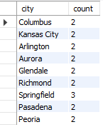
Identifying Duplicates by Aggregation
Find USA Cities with the same name (duplicate records)
SELECT `name` AS city, SUM(1) AS `count`
FROM world.city
WHERE countrycode='USA'
GROUP BY `name`
HAVING count > 1
Notes:
SELECT a.*
FROM world.city AS a INNER JOIN
(
SELECT `name` AS city, SUM(1) AS `count`
FROM world.city
WHERE countrycode='USA'
GROUP BY `name` HAVING SUM(1) > 1
) AS b ON a.`name` = b.city
WHERE a.countrycode='USA' ORDER BY a.`name`;

Slide 24
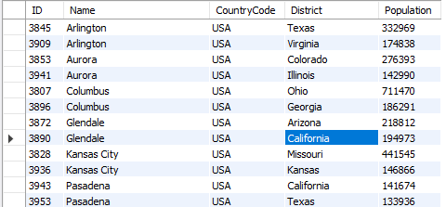
Identifying Duplicates by Key
Find USA Cities with the same name (duplicate records)
SQL Query - Find Via Aggregate & Join
SELECT a.*
FROM world.city AS a INNER JOIN
(SELECT `name` AS city, SUM(1) AS `count`
FROM world.city
WHERE countrycode='USA'
GROUP BY `name`
HAVING count > 1) AS b ON a.`name` = b.city
WHERE a.countrycode=‘USA’
ORDER BY a.`name`
Notes:
SELECT a.*
FROM world.city AS a INNER JOIN
(
SELECT `name` AS city, SUM(1) AS `count`
FROM world.city
WHERE countrycode='USA'
GROUP BY `name` HAVING SUM(1) > 1
) AS b ON a.`name` = b.city
WHERE a.countrycode='USA' ORDER BY a.`name`;

Slide 25
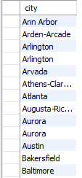
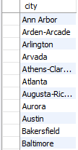
Using DISTINCT Keyword
Remove USA Cities with the same name (duplicate records)
Using DISTINCT
SELECT DISTINCT `name` AS city
FROM world.city
WHERE countrycode='USA'
ORDER BY `name`;
SELECT `name` AS city
FROM world.city
WHERE countrycode='USA'
ORDER BY `name`;

Slide 26
SQL Scalar Functions
String functions: Concat, Length, Left, Replace, Substring, Trim, Format
Control flow functions: Case, if, ifnull
Date and Time functions: Curdate, DateDiff, Day/Month/Year, DateAdd, now
Comparison functions: Coalesce, isnull
Numeric/Math functions: Format, Ceiling/Floor, Round, Truncate
Data Types: CAST
Tutorial: http://www.mysqltutorial.org/mysql-functions.aspx
Notes:
Aggregate Function: aggregate function performs a calculation on a set of values and returns a single value.
scalar(non-aggregate) functions - returns a single data value and operate on each record independently.

Slide 27
Numeric & Comparison Functions
Function | Description | Example
FORMAT (N, D) | Number N to a format like ‘#,###,###.##’ rounded to “D” decimal places | SELECT FORMAT(12324.2573, 3) = 12,324.257
CAST (value, type) | The CAST() function converts a value (of any type) into the specified datatype. | SELECT CAST ('150' AS Unsigned)= 150
IFNULL (expr ,alt_value) | returns a specified value if the expression is NULL. | IFNULL(NULL, 500) = 500
ISNULL(exp) | returns 1 or 0 depending on whether an expression is NULL. | ISNULL(NULL) = 1
COALESCE (val1,val2,…,val_n) | Function returns the first non-null value in a list. | COALESCE(NULL, 'W3Schools.com', NULL, 'Example.com’)= 'W3Schools.com'
See more numeric functions at: https://www.w3resource.com/slides/mysql-mathematical-functions-slides-presentation.php
For CAST() data types, see: https://www.w3resource.com/slides/mysql-mathematical-functions-slides-presentation.php

Slide 28
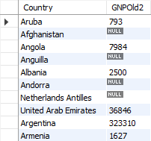
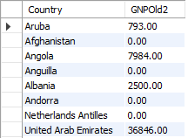
Ex. Numeric Functions
Fill-in and convert `GNPOld` values in World.Country
SQL Query - Undesired Types - Convert Decimal to Integer
SELECT `name` AS country, CONVERT(ROUND(gnpold,0),UNSIGNED) AS gnpold2 FROM world.country;
SQL Query - Coalesce “0” for Null Values
SELECT `name` AS country, COALESCE(gnpold,0) as gnpold3 FROM world.country;

Slide 29
String Formatting Functions
Function | Description | Example
CONCAT (Str1,..,StrN) | Add two or more strings together | SELECT CONCAT(“Jeremy ”,”T. ”, ”Bergmann”) = ‘Jeremy T. Bergmann’
INSTR (orig, substr) | Returns an integer which indicates the position of the first occurrence of the substr. | INSTR('myteststring','st') = 5
TRIM (expr ,alt_value) | string after removing all prefixes or suffixes from the given string. | TRIM(LEADING 'leading' FROM 'leadingtext' ) = ‘text’
REPLACE (str, find, sub) | replaces all the occurrences of a substring within a string | REPLACE('w3resource','ur','r') = ‘w3resorce’
LCASE(str), UCASE(str) | converts the characters of a string to lower/upper case characters. | LCASE('MYTESTSTRING') = ‘myteststring’
LENGTH(str) | returns the length of a given string. | LENGTH(‘Bergmann’) = 8
SUBSTRING (str, start, length) | Extracts some characters from a string | SUBSTRING('SQL Tutorial', 1, 3) = SQL
Notes:
See more string functions at: https://www.w3schools.com/sql/sql_ref_sqlserver.asp
For Cast() data types, see: https://www.w3resource.com/slides/mysql-mathematical-functions-slides-presentation.php

Slide 30
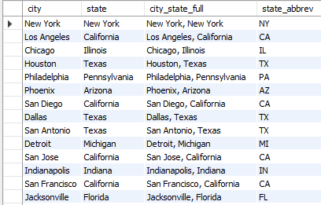
Ex. String Functions
Convert USA City & State Names to “City, St.” in World.City
SQL Query
SELECT `name` AS city, district AS state ,
CONCAT(`name`, ‘,’, district) AS city_state_full,
CASE WHEN district = 'New York’ THEN 'NY’
WHEN INSTR(district,'Tex') then 'TX’
WHEN district = 'Arizona’ THEN REPLACE(district, 'Arizona', 'AZ’)
WHEN TRIM(LEADING 'Penn’ FROM district) = 'sylvania’ THEN 'PA’
ELSE UPPER(LEFT(district,2)) END AS state_abbrev
FROM world.city AS a
WHERE a.CountryCode='USA'

Slide 31
Date Formatting Functions
Function | Description | Example
CURDATE() | Returns the current date in 'YYYY-MM-DD' format | SELECT CURDATE() = '2019-07-22'
CURRENT_TIMESTAMP() | Returns the current date and time in ‘YYYY-MM-DD HH:MM:SS’ format | CURRENT_TIMESTAMP() = ‘2019-07-22 13:41:53’
HOUR(time) | Returns a specified value if the expression is NULL. | HOUR(CURRENT_TIMESTAMP()) = 13
DATEDIFF (date1, date2) | Returns the number of days between two dates or datetimes (using only date portion) | DATEDIFF(CURDATE(), ‘1999-12-31’) = 7143
DAYOFWEEK (date) | Returns the weekday number (1 for Sunday, 2 for Monday, …… ,7 for Saturday) | DAYOFWEEK(CURDATE()) = 2
DAY(date), MONTH(date), YEAR(date) | Return the day of the month/month of year/calendar year of the input date. | DAY('2008-05-15') = 15 MONTH('2008-05-15') = 5 YEAR('2008-05-15') = 2008
CURDATE() | returns the current date in 'YYYY-MM-DD' format | SELECT CURDATE() = '2019-07-22'
Notes:
See more numeric functions at: https://www.w3resource.com/slides/mysql-mathematical-functions-slides-presentation.php
For Cast() data types, see: https://www.w3resource.com/slides/mysql-mathematical-functions-slides-presentation.php

Slide 32
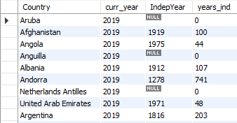
Ex. Date Functions
Get the number of years since each country’s independence
SQL Query
SELECT `name` AS country, YEAR(CURDATE()) AS curr_year, indepyear,
CASE WHEN indepyear IS NULL THEN 0
ELSE YEAR(CURDATE())-indepyear END AS years_ind
FROM world.country;

Slide 33
Common SQL Errors
JOINING ON THE WRONG COLUMN
Spelling – Table, Column, Value
Quotes - SINGLE (' '), DOUBLE (" "), and BACKTICKS (` `)
DATA TYPES – Ex. Integer as VARCHAR
Order of SQL Clauses (from lecture 1)
JOINING ON THE WRONG COLUMN
OVER FILTERING (WHERE Clause)
Source: https://datapractices.org/courseware/2_7.html
MySQL Error Message List: https://www.fromdual.com/mysql-error-codes-and-messages
Notes:
https://stackoverflow.com/questions/1992314/what-is-the-difference-between-single-and-double-quotes-in-sql - [S]ingle quotes are for [S]trings ; [D]ouble quotes are for [D]atabase identifiers;

Slide 34
Exercises
Procedures - Write the SQL/PSM code to create the following procedures:
Create a procedure named null_report that displays all customers that don’t have a zipcode specified in the state provided by the user. Call the procedure after creating it using NM as the IN parameters.
Create a procedure called new_payment that inserts a new payment and displays the remaining balance on the provided order. Call the procedure using order #51, payment type ID #1, date of today, amount of $500, and comment of “card” as IN parameters.
Functions - Write the SQL/PSM code to create the following functions:
Create a function named get_outstanding_balance which returns the balance remaining on a given order. Select from this function only those orders with an outstanding balance.
Create a function named get_materials_required that will return the total materials required for each product. Select from this function showing the description and materials required for all products.
Triggers - Write the SQL/PSM code to create the following triggers:
Create a trigger called customer_exists_trigger that checks to see if a new customer already exists and display an error if the customer already exists.
Create triggers called valid_price_insert_trigger and valid_price_update_trigger that ensures that the price of all products is greater than zero and display an error if the price is not greater than zero.
Create a trigger called shipping_trigger that when a new customer is inserted a new record will also be inserted into the customer shipping address table with the same values. Assume the territory ID is 5.
Notes:
Common ways to clean data with Python are available in the many libraries that you can import in your code. One of the most popular libraries is Pandas, which was designed for data manipulation and analysis, but is most commonly associated with data cleaning. Here is a common code snippet where Pandas is imported to clean a set of data:

Slide 35
Handling Missing Data
Substitute an estimate of the missing value (e.g. using a formula)
Construct a report listing missing values
Ignore missing data unless the value is significant (sensitivity testing)
Triggers can be used to perform these operations.
Notes:
With triggers we could:
Substitute based on a calculation of other values or a default value if not specified in table creation
Construct a report table that keeps track of missing values
Check for significant values before inserting/updating data in the database

Slide 36


